Slide 1

Graph Data Management
Using
Designed By:
Dang Le
Neena Maldikar
Norah Alballa
Pratibha Natani
Soumya Siricilla

Slide 2
Agenda
Data Model
Architecture
Demo
  INSERT & DELETE
  QUERIES
    Friends-Of-Friends
    Transitive Closure
    Bridge

Slide 3
Data Model – Column Families
Our data model consists of :
A keyspace – GraphDB (equivalent to a database in RDBMS)
3 Column Families (equivalent to tables in RDBMS)
  Nodes
    Contains of all the nodes in the application and
    The nodes’ attributes
  OutEdges
    Contains all the outgoing edges for each node and
    Edge attributes such as weight
  InEdges
    Contains all the incoming edges for each node and
    Edge attributes such as weight

Slide 4

Nodes Column Family
Static Column Family model, column names are relatively static.
  CREATE TABLE Nodes (
  node_id uuid PRIMARY KEY,
  name varchar,
  gender varchar,
  occupation varchar
  );
Secondary index on Name allows to query with a name.

Slide 5
OutEdges Column Family
Dynamic Column Family: One row for all the outgoing edges from a node.
Cassandra uses composite columns under the hood to store clustered rows. All the logical rows with the same partition key get stored as a single, physical wide row.
  CREATE TABLE OutEdges(
    source_node uuid,
    rel_type varchar,
    rel_id uuid,
    dest_node uuid,
    PRIMARY KEY (source_node, rel_type, rel_id));
Secondary index on dest_node allows to query with a particular dest_node.
8 | Friend_1 | Friend_2
 | 5 | 7
rel_type + rel_id
source_node
dest_node

Slide 6
InEdges Column Family
Dynamic Column Family: One row for all the incoming edges from a node.
Cassandra uses composite columns under the hood to store clustered rows. All the logical rows with the same partition key get stored as a single, physical wide row.
  CREATE TABLE InEdges(
    dest_node uuid,
    rel_type varchar,
    rel_id uuid,
    source_node uuid,
    PRIMARY KEY (dest_node, rel_type, rel_id));
Secondary index on source_node allows to query with a particular source_node.
8 | Friend_1 | Friend_2 | Friend_3
 | 3 | 7 | 9
rel_type + rel_id
dest_node
source_node

Slide 7
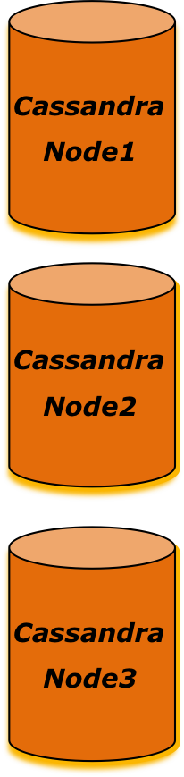




Application Architecture
JDBC API
JDBC Driver Manager
Cassandra JDBC Driver
Cassandra
Node
Java Application

Slide 8
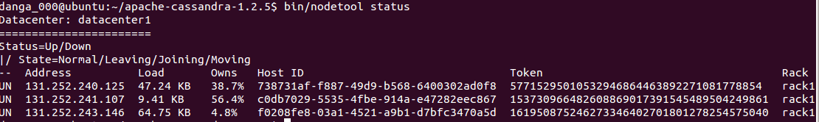
Cassandra Cluster – set-up
Changes needed to config file:
cluster_name: Name of your cluster
listen_addr: IP address or hostname that other Cassandra nodes will use to connect to this node.
rpc_addr: (0.0.0.0) causes cassandra to listen for clients on all available interfaces
Seeds: IP addr of machines that contain
Murmur3Partitioner (default): Uniformly distributes data across the cluster based on MurmurHash hash values
information about the ring
Node1
Node3
Node2
Notes:
This hashing function creates a 64-bit hash value of the row key

Slide 9
Cassandra Cluster – replication
CREATE KEYSPACE GraphDB
WITH REPLICATION = {'class' : 'SimpleStrategy', 'replication_factor' : 2};
A replication factor of 2 means two copies of each row, where each copy is on a different node
SimpleStrategy: places the first replica on a node determined by the partitioner. Additional replicas are placed on the next nodes clockwise in the ring.
A1
B2
Node1
Node3
Node2
B1
A2
Reference: http://www.datastax.com/docs/1.0/cluster_architecture/replication
Notes:
Demo: Nodetool status (This will show all the nodes in the cluster.)

Slide 10
Demo – INSERT and DELETE
Graph Database Management System
=================================
MAIN MENU
1. Insert a node
2. Insert a relationship
3. Delete a node
4. Delete a relationship
5. Display node details
6. Friend of friend
7. Transitive Closure
8. Bridge
9. Exit
Enter your choice: _
Alice
Bob
Two Rows inserted:
Outgoing edge from Alice to Bob
Incoming Edge to Bob from Alice
Notes:
DEMO:
Insert a new node and edges. Show that they are replicated by stopping the server on the current machine and then accessing from the other machine.
Delete newly added nodes and edges. Deletes on the shut-down node will happen when it comes up.

Slide 11
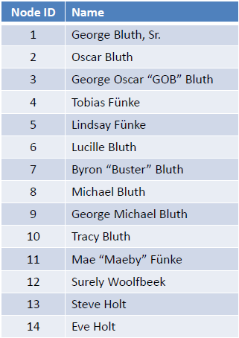
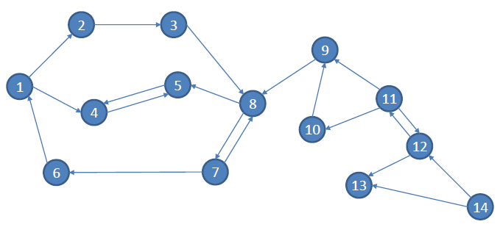
Demo - Queries
Friends-of-Friends of node 12(Surely Woolfbeek) are: {10, 9}
i.e. {Tracy Bluth, George Michael Bluth)}
Transitive closure of node 8(Michael Bluth) = {5, 7, 4, 6, 1, 2, 3} i.e. {Lindsay Funke, Byron "Buster" Bluth, Tobias Funke, Lucille Bluth, George Bluth, Sr., Oscar Bluth, George Oscar "GOB" Bluth}
Is the edge (9,8) i.e. (George Michael Bluth, Michael Bluth) a bridge? Yes

Slide 12
Conclusion
The data model should be designed based on queries in your application.
Dynamic column families give flexible schema and it is implemented using composite columns in CQL.
Cassandra provides fault-tolerance and availability via Multi-node cluster.
SQL-like format of CQL reduces ramp-up time.
There is limited documentation and it is still evolving which makes it challenging to use.
NOSQL databases have some limitations compared to RDBMS. Hence, the programmers have to handle those in code.

Slide 13


Slide 14
Thank You!

Slide 15
Appendix

Slide 16
What is UUID?
A universally unique identifier (UUID) is a 16-octet (128-bit) number, represented by 32 hexadecimal digits, displayed in five groups separated by hyphens.
Java provides a class that will produce 128-bit UUIDs, via UUID.randomUUID(), generation method,
For more information please refer to:
http://en.wikipedia.org/wiki/UUID
http://docs.oracle.com/javase/7/docs/api/java/util/UUID.html

Slide 17
Composite columns in Cassandra
Composite columns comprise fully denormalized wide rows by using composite primary keys.
Cassandra uses the first column name in the primary key definition as the partition key, which is the same as the row key to the underlying storage engine.
The data for each partition key will be clustered by the remaining columns of the primary key definition. Clustering means that the storage engine creates an index and always keeps the data clustered by that index.
All the logical rows with the same partition key get stored as a single, physical wide row. Using this design, Cassandra supports up to 2 billion columns per (physical) row.
Reference: http://www.datastax.com/docs/1.1/ddl/column_family#composite-columns

Slide 18
Cassandra Multinode Cluster Setup
To correctly configure a multi-node cluster you must determine the following information:
A name for your cluster
How many total nodes your cluster will have, and how many nodes per replication group
The IP addresses of each node
The token for each node. Tokens are used to assign a range of data to a particular node. If you use the Murmur3Partitioner, it uses consistent hashing to determine which node will store a particular row and distributes tokens in a completely unordered manner.
Which nodes will serve as the seed nodes.
Reference: http://wiki.apache.org/cassandra/MultinodeCluster
http://www.datastax.com/docs/0.8/cluster_architecture/partitioning

Slide 19
Repairing missing or inconsistent data
Cassandra repairs missing data in three ways:
HintedHandoff: when a replica does not acknowledge an update, the coordinator will store the update and replay it later.
ReadRepair: when a read is performed, Cassandra compares the versions at each replica, and the newest version is sent to any out-of-date replicas. By default, Cassandra does this with 10% of all requests; this can be configured per-columnfamily withread_repair_chance and dclocal_read_repair_chance.
AntiEntropy: when nodetool repair is run, Cassandra computes a Merkle tree for each range of data on that node, and compares it with the versions on other replicas, to catch any out of sync data that hasn't been read recently.
Reference: http://wiki.apache.org/cassandra/Operations#Repairing_missing_or_inconsistent_data

Slide 20
Cassandra Query Language (CQL)
CREATE KEYSPACE GraphDB WITH REPLICATION = { 'class' : 'SimpleStrategy', 'replication_factor' : 1 };
Use GraphDB;
CREATE TABLE Nodes (
  node_id uuid PRIMARY KEY,
  name varchar,
  gender varchar,
  occupation varchar
  );
CREATE INDEX nameIndex ON Nodes (name);
INSERT INTO Nodes(node_id,name, gender, occupation)VALUES (ab73c834-40bb-46df-b0b7-ca3416b86dc9, ‘test','f','student');
DELETE FROM Nodes WHERE node_id = ab73c834-40bb-46df-b0b7-ca3416b86dc9;
DROP COLUMNFAMILY Nodes;
DROP KEYSPACE GraphDB;
Reference: http://www.datastax.com/documentation/cassandra/1.2/index.html#cassandra/cql_using/about_cql_c.html#concept_ds_zv5_vf4_yj

Slide 21
Algorithm for FOF
Step1: Get friends of Node_X by calling getFriends();
Step2: For ( Each friend of Node_X)
FOF_of Node_X[]= NodeID.getFriends();
Step3: Print FOF_of Node_X[]
getFriends(): This function queries outgoing edges table and selects all the friends of Node_X

Slide 22
Algorithm for Transitive Closure
Initialize a list T for storing the transitive closure and a stack S for storing the nodes to be visited.
For an input node, find all its adjacent nodes by using getFriends() function that queries Outgoing Edges column family.
Add the nodes to the list T if they are not already present and also add them to the stack S.
Check if the stack S is empty.
  If yes, print the list T
  If no, pop an element of the stack S and go to step 2.

Slide 23
Bridge using Transitive Closure
Find if edge (a,b) is a bridge in G(V,E)?
for a given edge e = (a,b)
assume that e is removed
check if a can still reach b??
(call transitive closure algorithm for a and b)
If result is No, (a,b) is a bridge, else it is Not.
Note: We will query on Source Node Id which is indexed.

